Slide 1
Data Mining
Pre-Processing
1
Notes:
1

Slide 2
Chapter 3: Data Preprocessing
Data Preprocessing: An Overview
Data Quality
Major Tasks in Data Preprocessing
Data Cleaning
Data Integration
Data Reduction
Data Transformation and Data Discretization
Summary
2

Slide 3
Learning Outcomes
Apply data preprocessing techniques for cleaning, integration, reduction and transformation of data
Use correlation analysis to identify relationship between attributes

Slide 4
Data Quality: Why Preprocess the Data?
Measures for data quality: A multidimensional view
Accuracy: correct or wrong, accurate or not
Completeness: not recorded, unavailable, …
Consistency: some modified but some not, dangling, …
Timeliness: timely update?
Believability: how trustable the data are correct?
Interpretability: how easily the data can be understood?

Slide 5
Major Tasks in Data Preprocessing
Data cleaning
Fill in missing values, smooth noisy data, identify or remove outliers, and resolve inconsistencies
Data integration
Integration of multiple databases, data cubes, or files
Data reduction
Dimensionality reduction
Data compression
Data transformation and data discretization
Normalization
Concept hierarchy generation

Slide 6
Chapter 3: Data Preprocessing
Data Preprocessing: An Overview
Data Quality
Major Tasks in Data Preprocessing
Data Cleaning
Data Integration
Data Reduction
Data Transformation and Data Discretization
Summary
6

Slide 7
Data Cleaning
Data in the Real World Is Dirty: Lots of potentially incorrect data, e.g., instrument faulty, human or computer error, transmission error
incomplete: lacking attribute values, lacking certain attributes of interest, or containing only aggregate data
e.g., Occupation=“ ” (missing data)
noisy: containing noise, errors, or outliers
e.g., Salary=“−10” (an error)
inconsistent: containing discrepancies in codes or names, e.g.,
Age=“42”, Birthday=“03/07/2010”
Was rating “1, 2, 3”, now rating “A, B, C”
discrepancy between duplicate records
Intentional (e.g., disguised missing data)
Jan. 1 as everyone’s birthday?

Slide 8
Incomplete (Missing) Data
Data is not always available
E.g., many tuples have no recorded value for several attributes, such as customer income in sales data
Missing data may be due to
equipment malfunction
inconsistent with other recorded data and thus deleted
data not entered due to misunderstanding
certain data may not be considered important at the time of entry
not register history or changes of the data
Missing data may need to be inferred

Slide 9
How to Handle Missing Data?
Ignore the tuple: usually done when class label is missing (when doing classification)—not effective when the % of missing values per attribute varies considerably
Fill in the missing value manually: tedious + infeasible?
Fill in it automatically with
a global constant : e.g., “unknown”
the attribute mean
the attribute mean for all samples belonging to the same class: smarter
the most probable value: inference-based such as Bayesian formula or decision tree

Slide 10
Exercise 1
Given the following data
Find the missing values using
Mean
Class Average
Imputation/Nearest-neighbor
Age | Car Accidents | Class (Gender)
21 | 3 | F
? | 4 | F
20 | 3 | F
22 | ? | M
19 | 5 | M
18 | ? | M
? | 7 | M

Slide 11
Exercise 1
Age | Car Accidents | Class (Gender)
21 | 3 | F
? | 4 | F
20 | 3 | F
22 | ? | M
19 | 5 | M
18 | ? | M
? | 7 | M
Find the missing values using
Mean
Age:
Car Accidents:
Class Average
Age
Female:
Male:
Car Accidents
Female:
Male:
Age | Car Accidents | Class (Gender)
21 | 3 | F
 | 4 | F
20 | 3 | F
22 |  | M
19 | 5 | M
18 |  | M
 | 7 | M
Age | Car Accidents | Class (Gender)
21 | 3 | F
 | 4 | F
20 | 3 | F
22 |  | M
19 | 5 | M
18 |  | M
 | 7 | M

Slide 12
Exercise 1 - Sol
Age | Car Accidents | Class (Gender)
21 | 3 | F
? | 4 | F
20 | 3 | F
22 | ? | M
19 | 5 | M
18 | ? | M
? | 7 | M
Find the missing values using
Mean
Age: (21+20+22+19+18)/5=20
Car Accidents: 4.4
Class Average
Age
Female: 20.5
Male: 19.7
Car Accidents
Female: 3.33
Male: 6
Age | Car Accidents | Class (Gender)
21 | 3 | F
20 | 4 | F
20 | 3 | F
22 | 4.4 | M
19 | 5 | M
18 | 4.4 | M
20 | 7 | M
Age | Car Accidents | Class (Gender)
21 | 3 | F
20.5 | 4 | F
20 | 3 | F
22 | 6 | M
19 | 5 | M
18 | 6 | M
19.7 | 7 | M

Slide 13
Exercise 1
 | Age | Car Accidents | Class (Gender)
A | 21 | 3 | F
B | ? | 4 | F
C | 20 | 3 | F
D | 22 | ? | M
E | 19 | 5 | M
F | 18 | ? | M
G | ? | 7 | M
Find the missing values using
Imputation/Nearest-neighbor
 | Age | Car Accidents | Class (Gender)
A | 21 | 3 | F
B |  | 4 | F
C | 20 | 3 | F
D | 22 |  | M
E | 19 | 5 | M
F | 18 |  | M
G |  | 7 | M

Slide 14
Exercise 1 - Sol
 | Age | Car Accidents | Class (Gender)
A | 21 | 3 | F
B | ? | 4 | F
C | 20 | 3 | F
D | 22 | ? | M
E | 19 | 5 | M
F | 18 | ? | M
G | ? | 7 | M
Find the missing values using
Imputation/Nearest-neighbor
A, C, D, and F are closest to B. We can either take the average (21+20+22+18)/4 or pick the first one (21)
 | Age | Car Accidents | Class (Gender)
A | 21 | 3 | F
B | 21 | 4 | F
C | 20 | 3 | F
D | 22 | 7 | M
E | 19 | 5 | M
F | 18 | 7 | M
G | 22 | 7 | M
Distance Matrix
 | A | B | C | D | E | F | G
A
B | 1
C | 1 | 1
D | 2 | 1 | 3
E | 5 | 2 | 4 | 1
F | 4 | 1 | 3 | 2 | 1
G | 5 | 4 | 5 | 0 | 2 | 0
D is closest to G, so we use its value
One approach could be to ignore nearest neighbors who have missing values

Slide 15
Noisy Data
Noise: random error or variance in a measured variable
Incorrect attribute values may be due to
faulty data collection instruments
data entry problems
data transmission problems
technology limitation
inconsistency in naming convention
Other data problems which require data cleaning
duplicate records
incomplete data
inconsistent data
15
Notes:
15

Slide 16
How to Handle Noisy Data?
Binning
first sort data and partition into (equal-frequency) bins
then one can smooth by bin means, smooth by bin median, smooth by bin boundaries, etc.
Regression
smooth by fitting the data into regression functions
Clustering
detect and remove outliers
Combined computer and human inspection
detect suspicious values and check by human (e.g., deal with possible outliers)
Notes:
Enrich using data integration research!!

Slide 17
Binning Example
Sorted data for price (in dollars): 4, 8, 15, 21, 21, 24, 25, 28, 34
Partition into (equal-frequency) bins:
Bin 1: 4, 8, 15
Bin 2: 21, 21, 24
Bin 3: 25, 28, 34
Smoothing by bin means:
Bin 1: 9, 9, 9
Bin 2: 22, 22, 22
Bin 3: 29, 29, 29
Smoothing by bin boundaries:
Bin 1: 4, 4, 15
Bin 2: 21, 21, 24
Bin 3: 25, 25, 34

Slide 18
Data Cleaning as a Process
Data discrepancy detection
Use metadata (e.g., domain, range, dependency, central tendency and distribution)
Check field overloading
inconsistent use of codes and inconsistent data representations
E.g. “2010/12/25” and “25/12/2010”
Check uniqueness rule: A unique attribute should have unique val.
Consecutive rule: No missing values between min and max values
Null rule (entries like “don’t know” or “?” should be transformed to blank)
Use commercial tools for discrepancy detection
Data scrubbing: use simple domain knowledge (e.g., postal code, spell-check) to detect errors and make corrections
Data auditing: by analyzing data to discover rules and relationship to detect violators (e.g., correlation and clustering to find outliers)

Slide 19
Data Cleaning as a Process
Data migration and integration
Data migration tools: allow transformations to be specified
ETL (Extraction/Transformation/Loading) tools: allow users to specify transformations through a graphical user interface (e.g., Potter’s Wheels)
Integration of the two processes
Iterative and interactive

Slide 20
Chapter 3: Data Preprocessing
Data Preprocessing: An Overview
Data Quality
Major Tasks in Data Preprocessing
Data Cleaning
Data Integration
Data Reduction
Data Transformation and Data Discretization
Summary
20

Slide 21
Data Integration
Data integration:
Combines data from multiple sources into a coherent store
Schema integration: e.g., A.cust-id ≡ B.cust-#
Integrate metadata from different sources
Entity identification problem:
Identify real world entities from multiple data sources, e.g., M Hamza = Muhammad Hamza
Detecting and resolving data value conflicts
For the same real world entity, attribute values from different sources are different. (e.g., Data codes for pay type in one database may be “H” and “S”, and 1 and 2 in another)
Possible reasons: different representations, (e.g. discount on orders vs lineitems) different scales, e.g., metric vs. British units
21
Notes:
Should ask students to do some survey on data integration. -JH

Slide 22
Handling Redundancy in Data Integration
Redundant data occur often when integrating multiple databases
Object identification: The same attribute or object may have different names in different databases
Derivable data: One attribute may be a “derived” attribute in another table, e.g., annual revenue
Redundant attributes may be able to be detected by correlation analysis and covariance analysis
Careful integration of the data from multiple sources may help reduce/avoid redundancies and inconsistencies and improve mining speed and quality
22

Slide 23
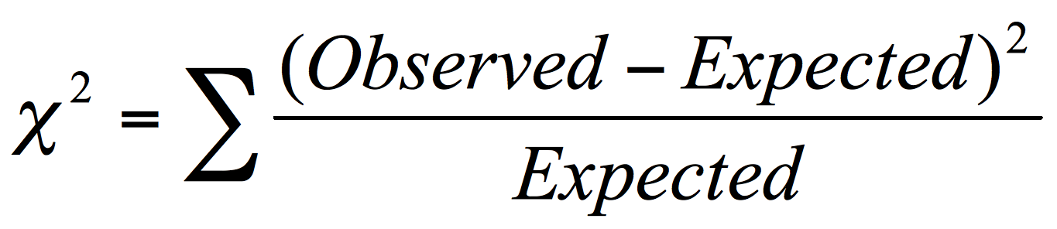
Correlation Analysis (Nominal Data)
Χ² (chi-square) test
The larger the Χ² value, the more likely the variables are related
The cells that contribute the most to the Χ² value are those whose actual count is very different from the expected count
Correlation does not imply causality
# of hospitals and # of car-theft in a city are correlated
Both are causally linked to the third variable: population

Slide 24
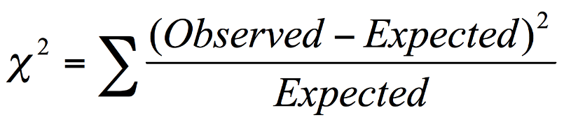
Chi-Square Calculation: An Example
300x450 = 90
1500
Χ² (chi-square) calculation (numbers in parenthesis are expected counts calculated based on the data distribution in the two categories)
For this 2 × 2 table, the degrees of freedom are (2 − 1)(2 − 1) = 1. For 1 degree of freedom, at the 0.05 significance level table value is 3.841 <507. So, correlated
 | Play chess | Not play chess | Sum (row)
Like science fiction | 250 | 200 | 450
Not like science fiction | 50 | 1000 | 1050
Sum(col.) | 300 | 1200 | 1500
(90)
(360)
(210)
(840)

Slide 25
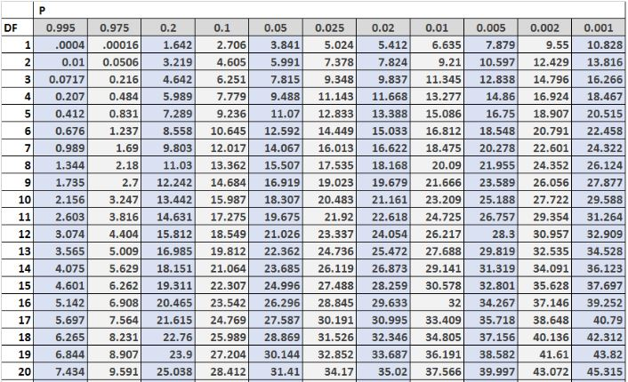
Chi-Square Table

Slide 26
Exercise 2
There are 3000 people who have iPhone, out of these, 2000 have installed WhatsApp.
There are 2000 people who don’t have iPhone, out of these, 1750 have installed WhatsApp
Is there a correlation between having iPhone and using WhatsApp?

Slide 27
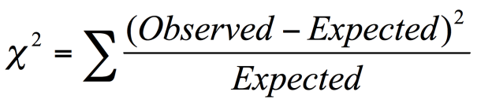
Exercise 2
There are 3000 people who have iPhone, out of these, 2000 have installed WhatsApp.
There are 2000 people who don’t have iPhone, out of these, 1750 have installed WhatsApp
 | iPhone | No iPhone | Total
WhatsApp | 2000 () | 1750 () | 3750
No WhatsApp | 1000 () | 250 () | 1250
Total | 3000 | 2000 | 5000
Expected value WhatsApp & iPhone =
Expected value WhatsApp & No iPhone =
Expected value No WhatsApp & iPhone =
Expected value No WhatsApp & No iPhone =
Correlation =

Slide 28
Exercise 2 - Sol
There are 3000 people who have iPhone, out of these, 2000 have installed WhatsApp.
There are 2000 people who don’t have iPhone, out of these, 1750 have installed WhatsApp
 | iPhone | No iPhone | Total
WhatsApp | 2000 (2250) | 1750 (1500) | 3750
No WhatsApp | 1000 (750) | 250 (500) | 1250
Total | 3000 | 2000 | 5000
Expected value WhatsApp & iPhone = 27.7
Expected value WhatsApp & No iPhone = 83
Expected value No WhatsApp & iPhone = 41
Expected value No WhatsApp & No iPhone = 125
Correlation = 276

Slide 29
Chi-Square Table

Slide 30
Exercise 3
Find the correlation between color and gender
Find the correlation between color and food
ID | Gender | Fav. Color | Fav. Food
1 | M | Blue | Cake
2 | M | Blue | Pasta
3 | F | Red | Pasta
4 | M | Red | Cake
5 | F | Red | Cake
6 | F | Pink | Pasta
7 | F | Red | Cake
8 | M | Blue | Pasta
9 | F | Red | Pasta
10 | M | Blue | Cake

Slide 31
Exercise 3
ID | Gender | Fav. Color | Fav. Food
1 | M | Blue | Cake
2 | M | Blue | Pasta
3 | F | Red | Pasta
4 | M | Red | Cake
5 | F | Red | Cake
6 | F | Pink | Pasta
7 | F | Red | Cake
8 | M | Blue | Pasta
9 | F | Red | Pasta
10 | M | Blue | Cake
Color and gender
Color and food
 | Blue | Red | Pink | Total
Male
Female
Total
 | Blue | Red | Pink | Total
Cake
Pasta
Total

Slide 32
Exercise 3
ID | Gender | Fav. Color | Fav. Food
1 | M | Blue | Cake
2 | M | Blue | Pasta
3 | F | Red | Pasta
4 | M | Red | Cake
5 | F | Red | Cake
6 | F | Pink | Pasta
7 | F | Red | Cake
8 | M | Blue | Pasta
9 | F | Red | Pasta
10 | M | Blue | Cake
Color and gender
Color and food
 | Blue | Red | Pink | Total
Male | 4 () | 1 () | 0 () | 5
Female | 0 () | 4 () | 1 () | 5
Total | 4 | 5 | 1 | 10
 | Blue | Red | Pink | Total
Cake | 2 () | 3 () | 0 () | 5
Pasta | 2 () | 2 () | 1 () | 5
Total | 4 | 5 | 1 | 10

Slide 33
Chi-Square Table

Slide 34
Exercise 3 - Sol
ID | Gender | Fav. Color | Fav. Food
1 | M | Blue | Cake
2 | M | Blue | Pasta
3 | F | Red | Pasta
4 | M | Red | Cake
5 | F | Red | Cake
6 | F | Pink | Pasta
7 | F | Red | Cake
8 | M | Blue | Pasta
9 | F | Red | Pasta
10 | M | Blue | Cake
Color and gender
Correlation (color,gender) = (4-2)^2/2 + (1-2.5)^2/2.5 + (0-0.5)^2/0.5 + (0-2)^2/2 + (4-2.5)^2/2.5 + (1-0.5)^2/0.5 = 6.8 -> Correlated
Color and food
Correlation (color,food) = (2-2)^2/2 + (3-2.5)^2/2.5 + (0-0.5)^2/0.5 + (2-2)^2/2 + (2-2.5)^2/2.5 + (1-0.5)^2/0.5 = 1.2 -> Not Correlated
.
 | Blue | Red | Pink | Total
Male | 4 (2) | 1 (2.5) | 0 (0.5) | 5
Female | 0 (2) | 4 (2.5) | 1 (0.5) | 5
Total | 4 | 5 | 1 | 10
 | Blue | Red | Pink | Total
Cake | 2 (2) | 3 (2.5) | 0 (0.5) | 5
Pasta | 2 (2) | 2 (2.5) | 1 (0.5) | 5
Total | 4 | 5 | 1 | 10

Slide 35
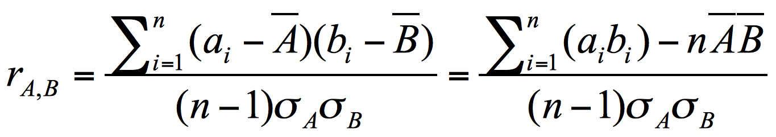
Correlation Analysis (Numeric Data)
Correlation coefficient (also called Pearson’s product moment coefficient)
where n is the number of tuples, and are the respective means of A and B, σ_{A} and σ_{B} are the respective standard deviation of A and B, and Σ(a_{i}b_{i}) is the sum of the AB cross-product.
−1 ≤ r_{A,B} ≤ +1.
If r_{A,B} > 0, A and B are positively correlated (A’s values increase as B’s). The higher, the stronger correlation.
r_{A,B} = 0: independent; r_{AB} < 0: negatively correlated

Slide 36
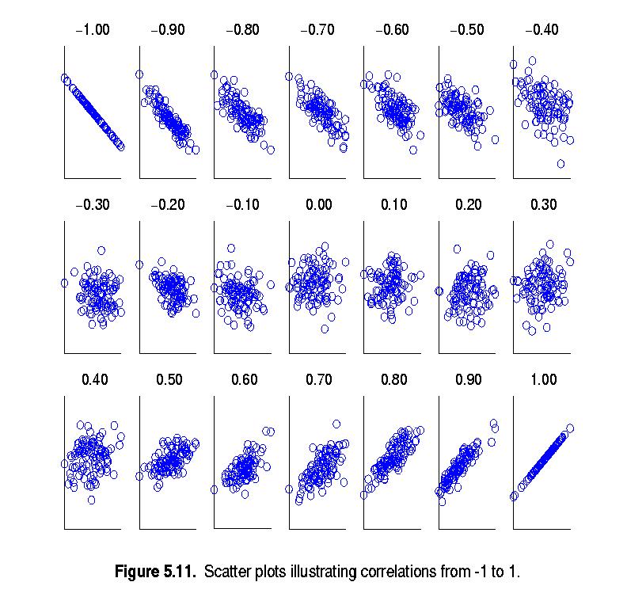
Visually Evaluating Correlation
Scatter plots showing the similarity from –1 to 1.

Slide 37
Exercise 4
Given the following data
Find the correlation between Age and Car Accidents using Pearson correlation
 | Age | Car Accidents
 | 23 | 3
 | 21 | 4
 | 20 | 3
 | 22 | 2
 | 19 | 5
 | 18 | 6
 | 17 | 7
Average | 20.0 | 4.3
StdDev | 2.16 | 1.7

Slide 38
Exercise 4
 | Age | Car Accidents
 | 23 | 3
 | 21 | 4
 | 20 | 3
 | 22 | 2
 | 19 | 5
 | 18 | 6
 | 17 | 7
Average | 20.0 | 4.3
StdDev | 2.16 | 1.8
Find the correlation between Age and Car Accidents using Pearson correlation

Slide 39
Exercise 4 - Sol
Age | Car Accidents
23-20= 3 | 3-4.3 = -1.3
21-20= 1 | 4-4.3 = -0.3
20-20= 0 | 3-4.3 = -1.3
22-20= 2 | 2-4.3 = -2.3
19-20= -1 | 5-4.3 = 0.7
18-20= -2 | 6-4.3 = 1.7
17-20 = -3 | 7-4.3 = 2.7
2.16 | 1.8
Find the correlation between Age and Car Accidents using Pearson correlation
Correl(age,acc) = [(3*-1.3+1*-0.3+0*-1.3+2*-2.3-1*.7-2*1.7-3*2.7)]-[7*20*4.3]/((7-1)*2.16*1.8) = -0.9
-> -0.9 shows that there is a strong negative correlation between the attributes age and # of car accidents

Slide 40
Chapter 3: Data Preprocessing
Data Preprocessing: An Overview
Data Quality
Major Tasks in Data Preprocessing
Data Cleaning
Data Integration
Data Reduction
Data Transformation and Data Discretization
Summary
40
Notes:
40

Slide 41
Data Reduction Strategies
Data reduction: Obtain a reduced representation of the data set that is much smaller in volume but yet produces the same (or almost the same) analytical results
Why data reduction? — A database/data warehouse may store terabytes of data. Complex data analysis may take a very long time to run on the complete data set.
Data reduction strategies
Dimensionality reduction, e.g., remove unimportant attributes
Principal Components Analysis (PCA)
Feature subset selection
Sampling
Notes:
MK 09/09/05: Wiki has dimensionality reduction as feature extraction (PCA) and feature subset selection. It states both wavelet transforms and PCA as forms of data compression. It does not have any pages for "numerosity reduction". We claim there are many different ways to organize data reduction strategies, which is true, so this presentation below should be OK. Let’s discuss.

Slide 42
Data Reduction 1: Dimensionality Reduction
Curse of dimensionality
When dimensionality increases, data becomes increasingly sparse
Density and distance between points, which is critical to clustering, outlier analysis, becomes less meaningful
Dimensionality reduction
Avoid the curse of dimensionality
Help eliminate irrelevant features and reduce noise
Reduce time and space required in data mining
Allow easier visualization
Dimensionality reduction techniques
Principal Component Analysis (Not covered)
Supervised and nonlinear techniques (e.g., feature selection)
Notes:
42
JH: put SVD at clustering high-D reduction.

Slide 43
Attribute Subset Selection
One way to reduce dimensionality of data
Redundant attributes
Duplicate much or all of the information contained in one or more other attributes
E.g., purchase price of a product and the amount of sales tax paid
Irrelevant attributes
Contain no information that is useful for the data mining task at hand
E.g., students' ID is often irrelevant to the task of predicting students' GPA

Slide 44
Heuristic Search in Attribute Selection
There are 2^{d} possible attribute combinations of d attributes
Typical heuristic attribute selection methods:
Best single attribute under the attribute independence assumption: choose by significance tests
Best step-wise feature selection:
The best single-attribute is picked first
Then next best attribute condition to the first, ...
Step-wise attribute elimination:
Repeatedly eliminate the worst attribute
Best combined attribute selection and elimination

Slide 45
Sampling
Sampling: obtaining a small sample s to represent the whole data set N
Allow a mining algorithm to run in complexity that is potentially sub-linear to the size of the data
Key principle: Choose a representative subset of the data
Simple random sampling may have very poor performance in the presence of skew
Develop adaptive sampling methods, e.g., stratified sampling:
Note: Sampling may not reduce database I/Os (page at a time)

Slide 46
Types of Sampling
Simple random sampling
There is an equal probability of selecting any particular item
Sampling without replacement
Once an object is selected, it is removed from the population
Sampling with replacement
A selected object is not removed from the population
Stratified sampling:
Partition the data set, and draw samples from each partition (proportionally, i.e., approximately the same percentage of the data)

Slide 47
Sampling: With or without Replacement
SRSWOR
(simple random
sample without
replacement)
SRSWR
Raw Data

Slide 48
Sampling: Cluster or Stratified Sampling
Raw Data
Cluster/Stratified Sample

Slide 49
Chapter 3: Data Preprocessing
Data Preprocessing: An Overview
Data Quality
Major Tasks in Data Preprocessing
Data Cleaning
Data Integration
Data Reduction
Data Transformation and Data Discretization
Summary
Notes:
49

Slide 50
Data Transformation
A function that maps the entire set of values of a given attribute to a new set of replacement values such that each old value can be identified with one of the new values
Methods
Smoothing: Remove noise from data
Attribute/feature construction
New attributes constructed from the given ones
Aggregation: Summarization, data cube construction
Normalization: Scaled to fall within a smaller, specified range
min-max normalization
z-score normalization
normalization by decimal scaling
Discretization: Concept hierarchy climbing
Notes:
50

Slide 51
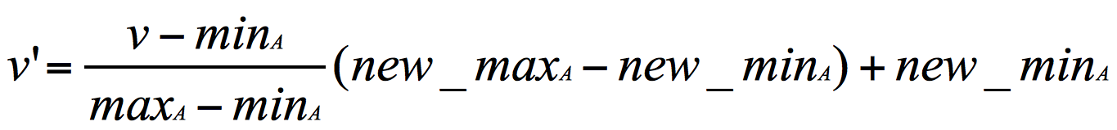
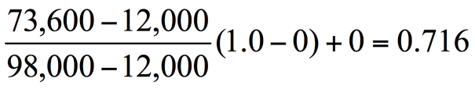
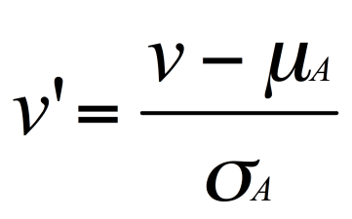
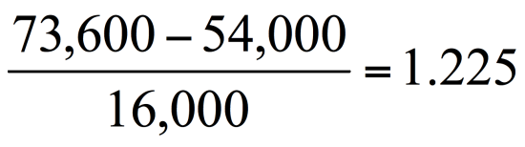
Normalization
Min-max normalization: to [new_min_{A}, new_max_{A}]
Ex. Let income range $12,000 to $98,000 normalized to [0.0, 1.0]. Then $73,600 is mapped to
Z-score normalization (μ: mean, σ: standard deviation):
Ex. Let μ = 54,000, σ = 16,000. Then
Normalization by decimal scaling
Where j is the smallest integer such that Max(|ν’|) < 1

Slide 52
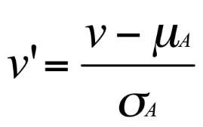
Exercise 5
Given the following data, normalize the attributes Age, Salary, and Grade using
Min-Max
Z-score
Decimal Scaling
 | Age | Salary (1000s) | Grade
Ali | 20 | 35 | 1
Bilal | 25 | 20 | 0.5
Ehsan | 20 | 30 | 1
Faris | 20 | 25 | 0
Average | 21.3 | 27.5 | 0.6
St. Dev. | 2.2 | 5.6 | 0.4

Slide 53
Exercise 5 – Min-Max
Given the following data, normalize the attributes Age, Salary, and Grade using
Min-Max [0,1]
minAge = 20
maxAge = 25
Z-score
Decimal Scaling
 | Age | Age’ | Salary (1000s) | Salary’ | Grade | Grade’
Ali | 20 |  | 35 |  | 1
Bilal | 25 |  | 20 |  | 0.5
Ehsan | 20 |  | 30 |  | 1
Faris | 20 |  | 25 |  | 0

Slide 54
Exercise 5 – Min-Max (Sol)
(30-20)/(35-20) = 10/15 = 0.67
((20-20)/(25-20))*(1-0) + 0 = 0
Given the following data, normalize the attributes Age, Salary, and Grade using
Min-Max [0,1]
minAge = 20
maxAge = 25
Z-score
Decimal Scaling
 | Age | Age’ | Salary (1000s) | Salary’ | Grade | Grade’
Ali | 20 | 0 | 35 | 1 | 1 | 1
Bilal | 25 | 1 | 20 | 0 | 0.5 | 0.5
Ehsan | 20 | 0 | 30 | 0.67 | 1 | 1
Faris | 20 | 0 | 25 | 0.33 | 0 | 0
(25-20)/(35-20) = 5/15 = 0.33

Slide 55
Exercise 5 – Z-Score
Given the following data, normalize the attributes Age, Salary, and Grade using
Z-score
 | Age | Age’ | Salary (1000s) | Salary’ | Grade | Grade’
Ali | 20 |  | 35 |  | 1
Bilal | 25 |  | 20 |  | 0.5
Ehsan | 20 |  | 30 |  | 1
Faris | 20 |  | 25 |  | 0
Average | 21.3 |  | 27.5 |  | 0.6
St. Dev. | 2.2 |  | 5.6 |  | 0.4

Slide 56
Exercise 5 – Z-Score
(30-27.5)/5.6 = 0.4
Given the following data, normalize the attributes Age, Salary, and Grade using
Z-score
 | Age | Age’ | Salary (1000s) | Salary’ | Grade | Grade’
Ali | 20 | -0.6 | 35 | 1.3 | 1 | 1.0
Bilal | 25 | 1.7 | 20 | -1.3 | 0.5 | -0.3
Ehsan | 20 | -0.6 | 30 | 0.4 | 1 | 1.0
Faris | 20 | -0.6 | 25 | -0.4 | 0 | -1.5
Average | 21.3 |  | 27.5 |  | 0.6
St. Dev. | 2.2 |  | 5.6 |  | 0.4

Slide 57
Exercise 5 – Decimal Scaling
Given the following data, normalize the attributes Age, Salary, and Grade using
Decimal Scaling
 | Age | Age’ | Salary (1000s) | Salary’ | Grade | Grade’
Ali | 20 |  | 35 |  | 1
Bilal | 25 |  | 20 |  | 0.5
Ehsan | 20 |  | 30 |  | 1
Faris | 20 |  | 25 |  | 0

Slide 58
Exercise 5 – Decimal Scaling
30/100 = 0.3
Given the following data, normalize the attributes Age, Salary, and Grade using
Decimal Scaling
 | Age | Age’ | Salary (1000s) | Salary’ | Grade | Grade’
Ali | 20 | 0.2 | 35 | 0.4 | 1 | 1.0
Bilal | 25 | 0.3 | 20 | 0.2 | 0.5 | 0.5
Ehsan | 20 | 0.2 | 30 | 0.3 | 1 | 1.0
Faris | 20 | 0.2 | 25 | 0.3 | 0 | 0.0

Slide 59
Discretization
Three types of attributes
Nominal—values from an unordered set, e.g., color, profession
Ordinal—values from an ordered set, e.g., military or academic rank
Numeric—real numbers, e.g., integer or real numbers
Discretization: Divide the range of a continuous attribute into intervals
Interval labels can then be used to replace actual data values
Reduce data size by discretization
Notes:
08.09.12 MK: Slide moved here from Ch. 3. Added examples.

Slide 60
Simple Discretization: Binning
Equal-width (distance) partitioning
Divides the range into N intervals of equal size: uniform grid
if A and B are the lowest and highest values of the attribute, the width of intervals will be: W = (B –A)/N.
The most straightforward, but outliers may dominate presentation
Skewed data is not handled well
Equal-depth (frequency) partitioning
Divides the range into N intervals, each containing approximately same number of samples
Good data scaling
Managing categorical attributes can be tricky

Slide 61
Binning Methods for Data Smoothing
Sorted data for price (in dollars):
4, 8, 9, 15, 21, 21, 24, 25, 26, 28, 29, 34
* Partition into equal-frequency (equi-depth) bins:
- Bin 1: 4, 8, 9, 15
- Bin 2: 21, 21, 24, 25
- Bin 3: 26, 28, 29, 34
* Smoothing by bin means:
- Bin 1: 9, 9, 9, 9
- Bin 2: 23, 23, 23, 23
- Bin 3: 29, 29, 29, 29
* Smoothing by bin boundaries:
- Bin 1: 4, 4, 4, 15
- Bin 2: 21, 21, 25, 25
- Bin 3: 26, 26, 26, 34

Slide 62
Exercise 6
Given the following data
Draw the bins for Age using
Equi-width (2 bins)
Equi-width (3 bins)
Equi-depth (3 bins)
Age | Car Accidents
23 | 3
21 | 4
20 | 3
22 | 2
19 | 5
18 | 6
17 | 7
29 | 1
18 | 5
18 | 6
23 | 2
20 | 4

Slide 63
Exercise 6
W = (B –A)/N
Equi-width
(2 bins)
Equi-width
(3 bins)
Equi-depth
(3 bins)
Draw the bins for Age using
Equi-width (2 bins) [A=17, B=29, N=2]
W =
Bins:
Equi-width (3 bins)
W =
Bins:
Equi-depth (3 bins)
Bins:
Age | Bin
23
21
20
22
19
18
17
29
18
18
23
20
Age | Bin
23
21
20
22
19
18
17
29
18
18
23
20
Age | Bin
23
21
20
22
19
18
17
29
18
18
23
20

Slide 64
Exercise 6
17+6=23
23+6=29
W = (B –A)/N
Equi-width
(2 bins)
Equi-width
(3 bins)
Equi-depth
(3 bins)
Draw the bins for Age using
Equi-width (2 bins) [A=17, B=29, N=2]
W = (29-17)/2 = 6
Bins: 17 to 23, >23 to 29
Equi-width (3 bins)
W = (29-17)/3 = 4
Bins: 17 to 213), >21 to 25 , >25 to 29 (1)
Equi-depth (3 bins)
Sort the numbers:
17, 18, 18, 19, 19, 20, 20, 21, 22, 23, 23, 29
Divide into three groups
17, 18, 18, 18 | 19, 20, 20, 21 | 22, 23, 23, 29
Bins: 17-18, 19-21, 22-29
Age | Bin
23 | 17-23
21 | 17-23
20 | 17-23
22 | 17-23
19 | 17-23
18 | 17-23
17 | 17-23
29 | >23 to 29
18 | 17-23
18 | 17-23
23 | 17-23
20 | 17-23
Age | Bin
23 | >21 to 25
21 | 17 to 21
20 | 17 to 21
22 | >21 to 25
19 | 17 to 21
18 | 17 to 21
17 | 17 to 21
29 | >25 to 29
18 | 17 to 21
18 | 17 to 21
23 | >21 to 25
20 | 17 to 21
Age | Bin
23 | 22-29
21 | 19-21
20 | 19-21
22 | 22-29
19 | 19-21
18 | 17-18
17 | 17-18
29 | 22-29
18 | 17-18
18 | 17-18
23 | 22-29
20 | 19-21

Slide 65
Assignment 2
Given the following data
Draw the bins for Age using
Equi-width (2 bins)
Equi-width (3 bins)
Equi-depth (3 items)
Age | Car Accidents
23 | 3
21 | 4
20 | 3
22 | 2
19 | 5
18 | 6
17 | 7

Slide 66
Concept Hierarchy Generation
Concept hierarchy organizes concepts (i.e., attribute values) hierarchically and is usually associated with each dimension in a data warehouse
Concept hierarchies facilitate drilling and rolling in data warehouses to view data in multiple granularity
Concept hierarchy formation: Recursively reduce the data by collecting and replacing low level concepts (such as numeric values for age) by higher level concepts (such as youth, adult, or senior)
Concept hierarchies can be explicitly specified by domain experts and/or data warehouse designers
Concept hierarchy can be automatically formed for both numeric and nominal data. For numeric data, use discretization methods shown.

Slide 67
Concept Hierarchy Generation for Nominal Data
Specification of a partial/total ordering of attributes explicitly at the schema level by users or experts
street < city < state < country
Specification of only a partial set of attributes
E.g., only street < city, not others
Automatic generation of hierarchies (or attribute levels) by the analysis of the number of distinct values
E.g., for a set of attributes: {street, city, state, country}
Notes:
Should we briefly introduce ontology? Ontology has been used extensively in bio-medical data warehouses. -- JP
We should introduce this part using 1-2 slides -JH

Slide 68
Automatic Concept Hierarchy Generation
Some hierarchies can be automatically generated based on the analysis of the number of distinct values per attribute in the data set
The attribute with the most distinct values is placed at the lowest level of the hierarchy
Exceptions, e.g., weekday, month, quarter, year
country
15 distinct values
province_or_ state
365 distinct values
city
3567 distinct values
street
674,339 distinct values

Slide 69
Chapter 3: Data Preprocessing
Data Preprocessing: An Overview
Data Quality
Major Tasks in Data Preprocessing
Data Cleaning
Data Integration
Data Reduction
Data Transformation and Data Discretization
Summary
Notes:
69

Slide 70
Summary
Data quality: accuracy, completeness, consistency, timeliness, believability, interpretability
Data cleaning: e.g. missing/noisy values, outliers
Data integration from multiple sources:
Entity identification problem
Remove redundancies
Detect inconsistencies
Data reduction
Dimensionality reduction
Data compression
Data transformation and data discretization
Normalization
Concept hierarchy generation

Slide 71
References
D. P. Ballou and G. K. Tayi. Enhancing data quality in data warehouse environments. Comm. of ACM, 42:73-78, 1999
T. Dasu and T. Johnson. Exploratory Data Mining and Data Cleaning. John Wiley, 2003
T. Dasu, T. Johnson, S. Muthukrishnan, V. Shkapenyuk. Mining Database Structure; Or, How to Build a Data Quality Browser. SIGMOD’02
H. V. Jagadish et al., Special Issue on Data Reduction Techniques. Bulletin of the Technical Committee on Data Engineering, 20(4), Dec. 1997
D. Pyle. Data Preparation for Data Mining. Morgan Kaufmann, 1999
E. Rahm and H. H. Do. Data Cleaning: Problems and Current Approaches. IEEE Bulletin of the Technical Committee on Data Engineering. Vol.23, No.4
V. Raman and J. Hellerstein. Potters Wheel: An Interactive Framework for Data Cleaning and Transformation, VLDB’2001
T. Redman. Data Quality: Management and Technology. Bantam Books, 1992
R. Wang, V. Storey, and C. Firth. A framework for analysis of data quality research. IEEE Trans. Knowledge and Data Engineering, 7:623-640, 1995
Notes:
MK 08.11.02: This needs to be updated to reflect changes.

